Slide 1


Sales Dashboard Analysis
Start Slide

Slide 2

Objective & Dataset
Objective: To create an interactive dashboard for business stakeholders to monitor sales and profit KPIs.
Dataset: Superstore Dataset from Kaggle
Fields Used: Order Date, Sales, Profit, Category, Region, etc.

Slide 3
KPI Definitions
Total Sales: Total revenue generated
Total Profit: Total profit earned
Profit Margin: Profit ÷ Sales
Sales Trend: Sales over time (monthly)
Performance: By Region and Category

Slide 4
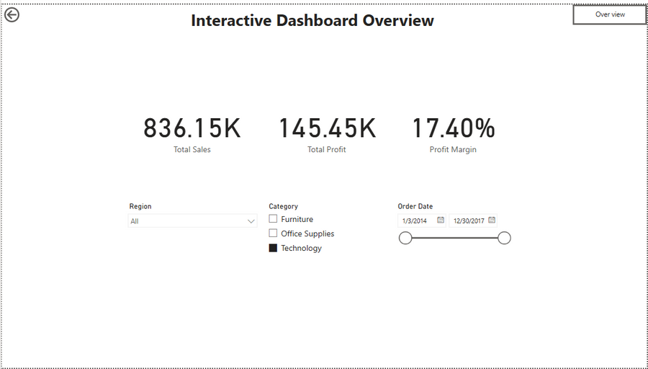
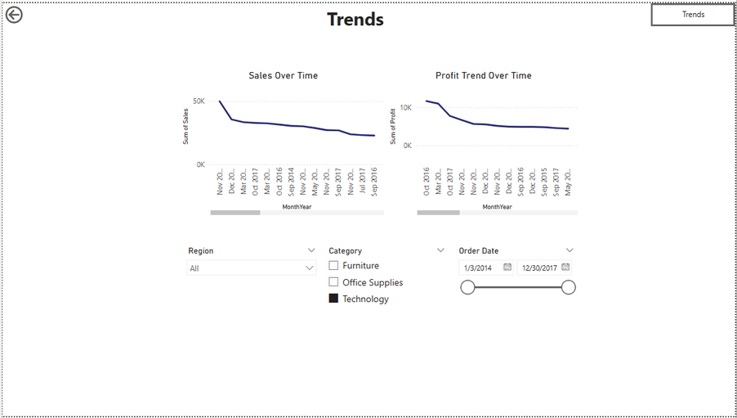
Dashboard Screenshot

Slide 5
Key Insights
Technology has the highest profit margin
West Region shows lowest sales growth
Q4 consistently delivers peak sales

